Slide 1
MALE AND FEMALE REPRODUCTIVE SYSTEM
DR IBUA

Slide 2
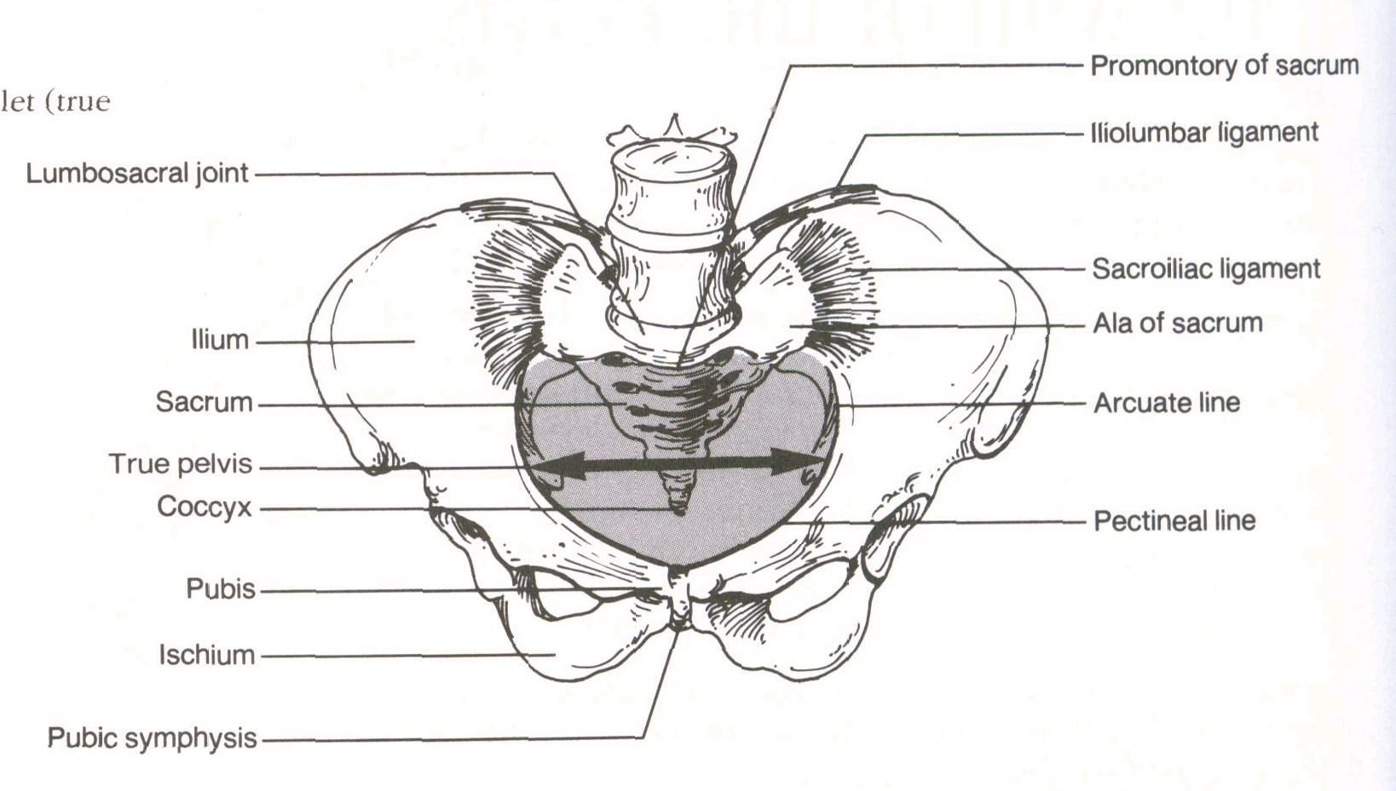
Bony pelvis and pelvic inlet (true pelvis).

Slide 3
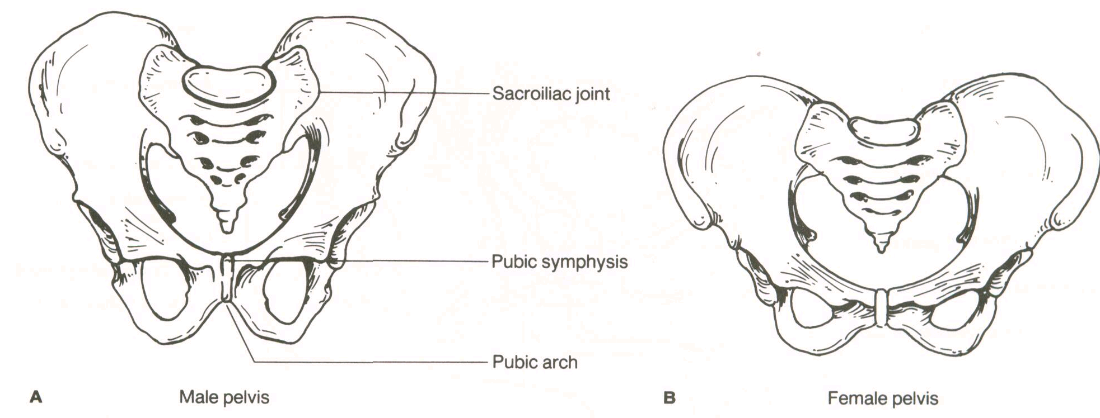
Male and female pelves.

Slide 4
Bony Pelvis | Male (#) | Female (?)
General structure | Thick and heavy | Thin and light
Greater pelvis (pelvis major) | Deep | Shallow
Lesser pelvis (pelvis minor) | Narrow and deep | Wide and shallow
Pelvic inlet (superior pelvic aperture) | Heart-shaped | Oval and rounded
Pelvic outlet (inferior pelvic aperture) | Comparatively small | Comparatively large
Pubic arch and subpubic angle | Narrow | Wide
Obturator foramen | Round | Oval
Acetabulum | Large | Small

Slide 5
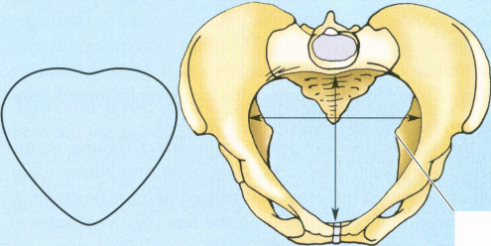
android

Slide 6
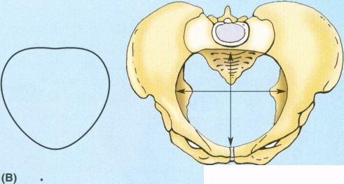
gynaecoid

Slide 7
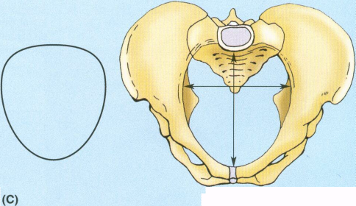
anthropoid

Slide 8
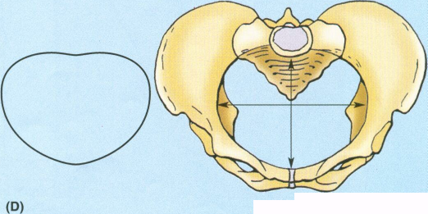
platypelloid

Slide 9
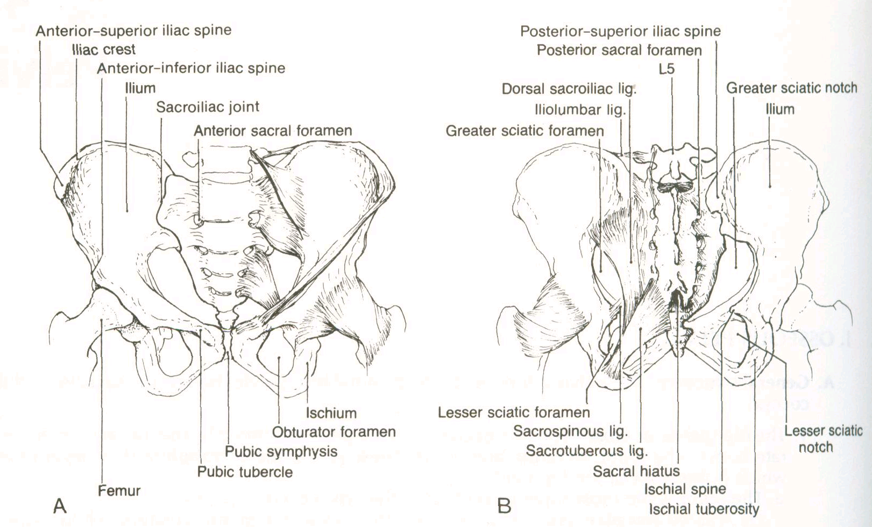
A, Anterior aspect of the female pelvis. The anterior ligaments supporting the left lumbosacral joint are included. B, Posterior aspect of the female pelvis. The posterior ligaments supporting the left lumbosacral joint are included.

Slide 10
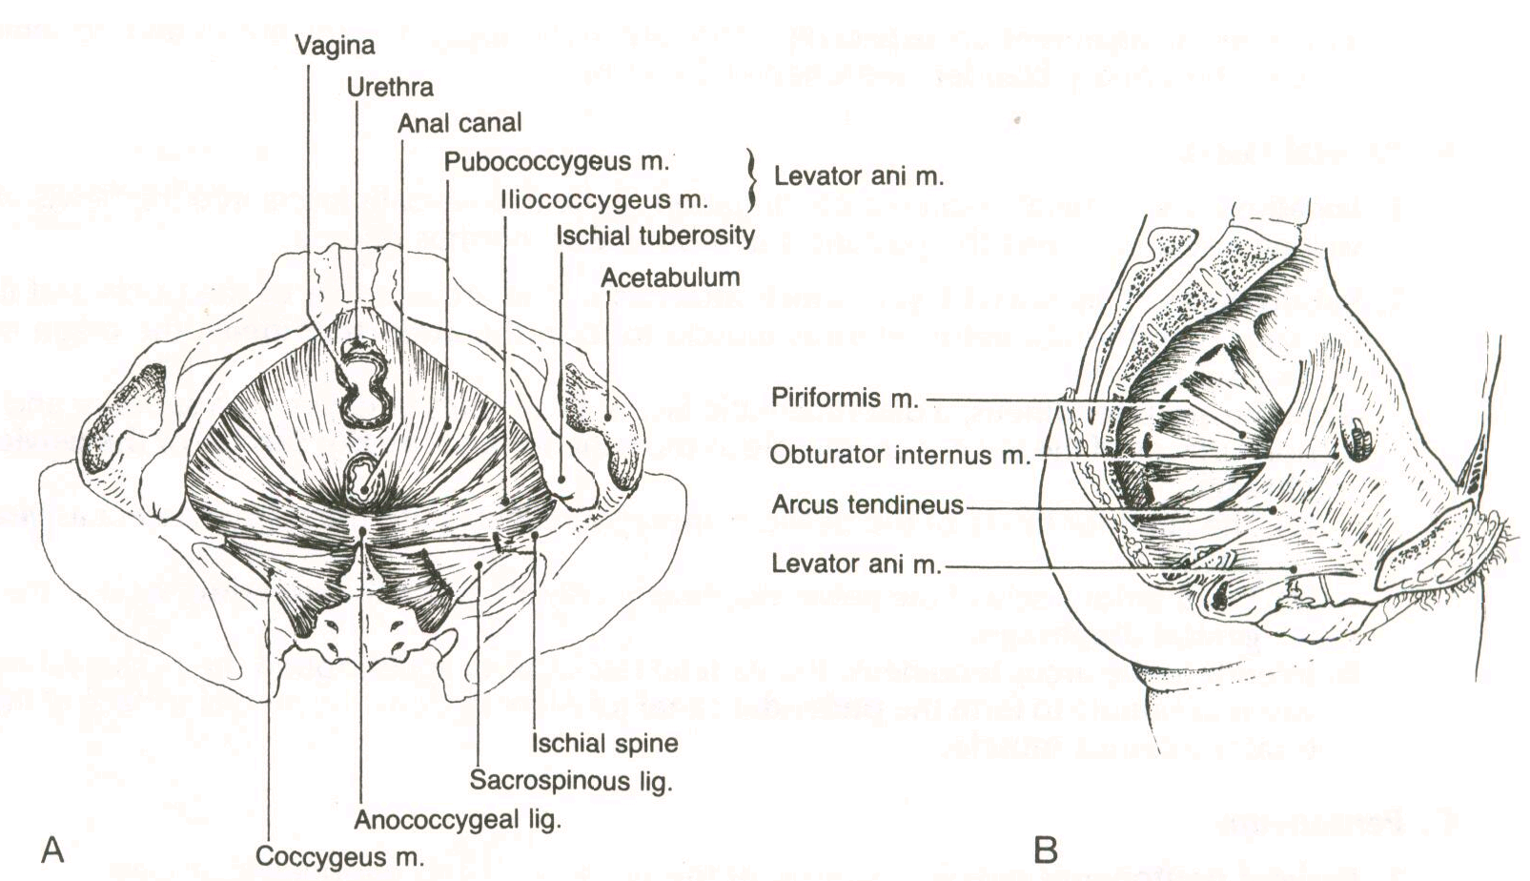
Pelvic floor. A, Inferior view of the female pelvis showing the muscles of the pelvic diaphragm. 8, Sagittal section of the female pelvis showing the muscles of the pelvic diaphragm.

Slide 11
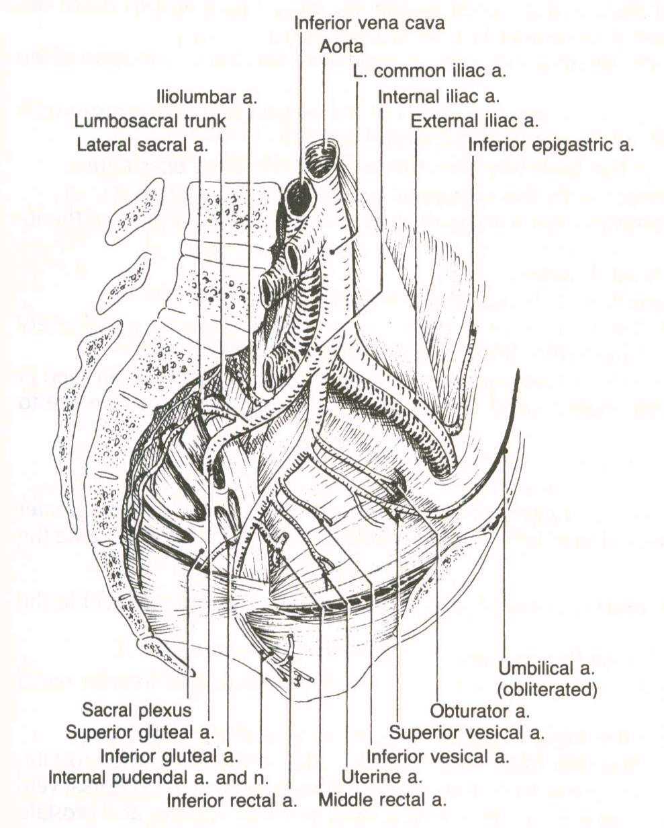
Vasculature of the pelvis.

Slide 12
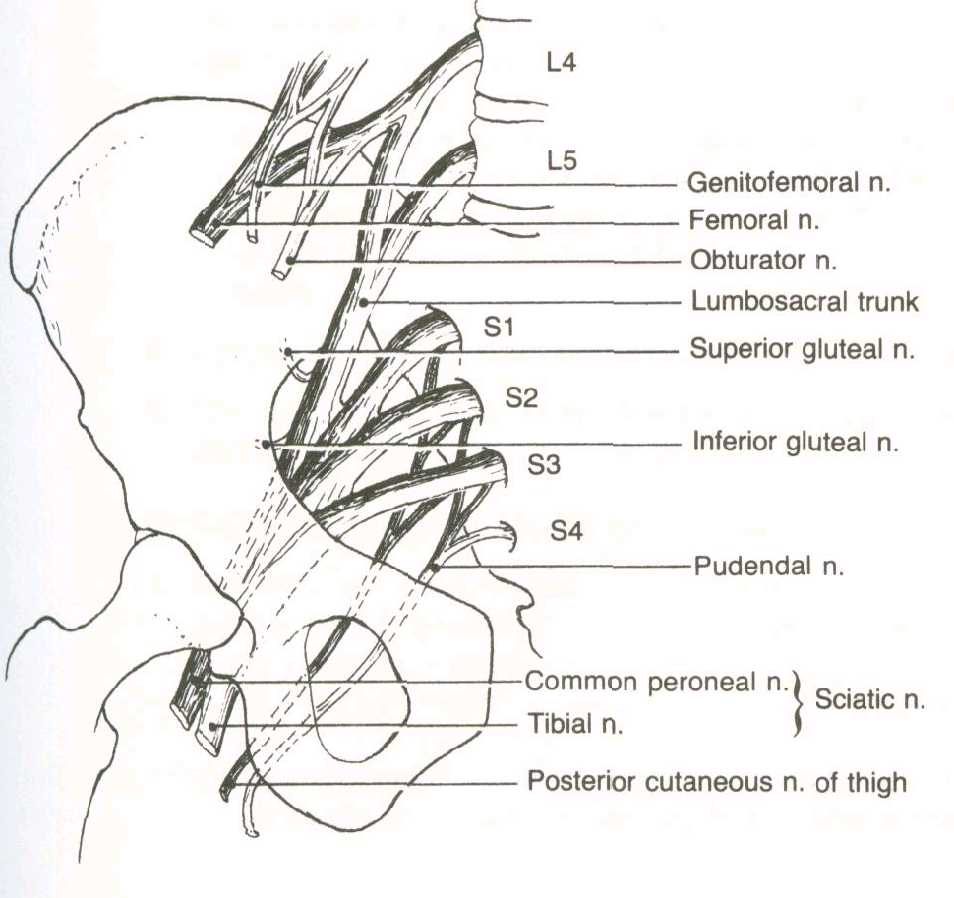
Sacra/ plexus. The anterior divisions (light) and posterior divisions (shaded) of the sacral plexus are indicated.

Slide 13
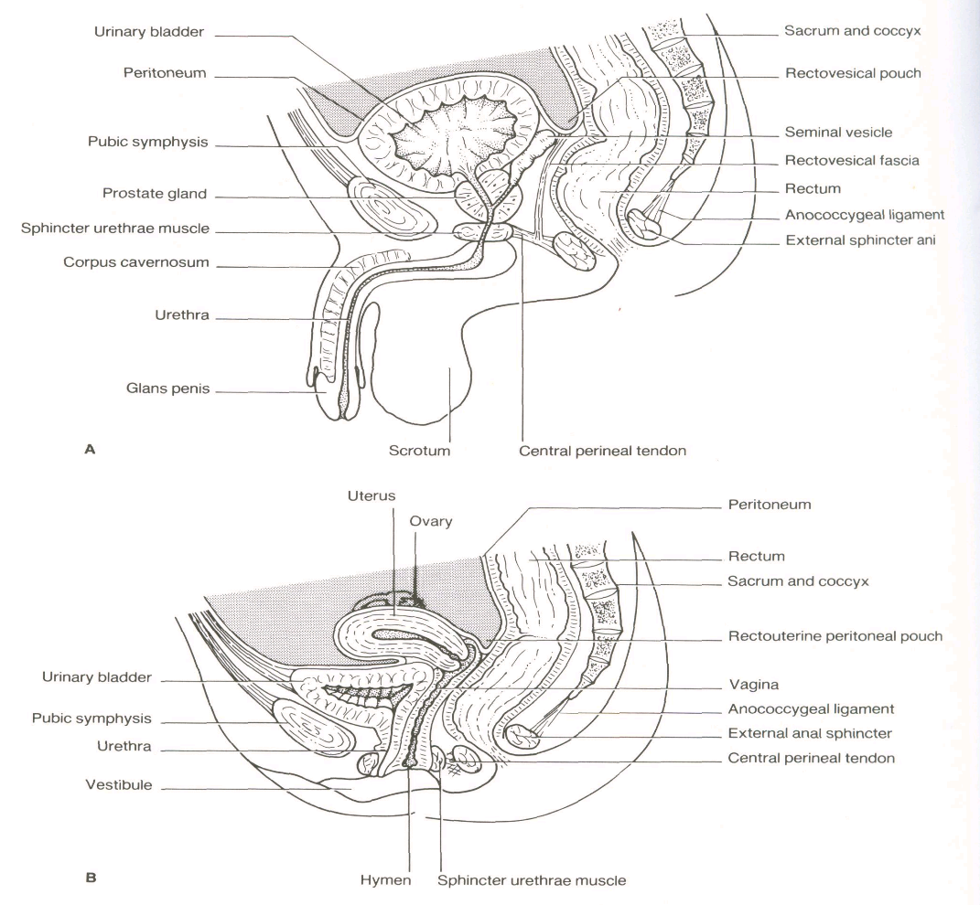
Median section of the pelvis. A. Male (with bladder partially filled). B. Female (with bladder empty).

Slide 14
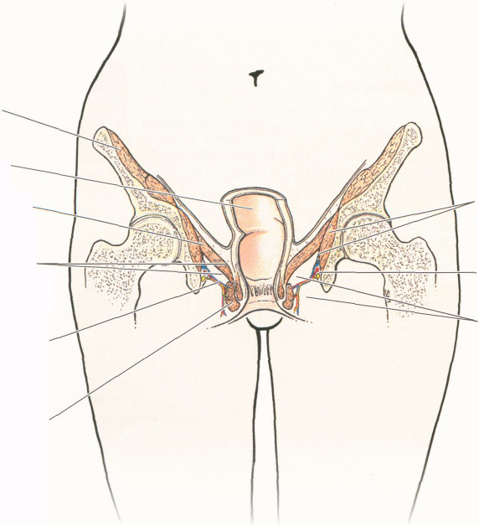

Slide 15
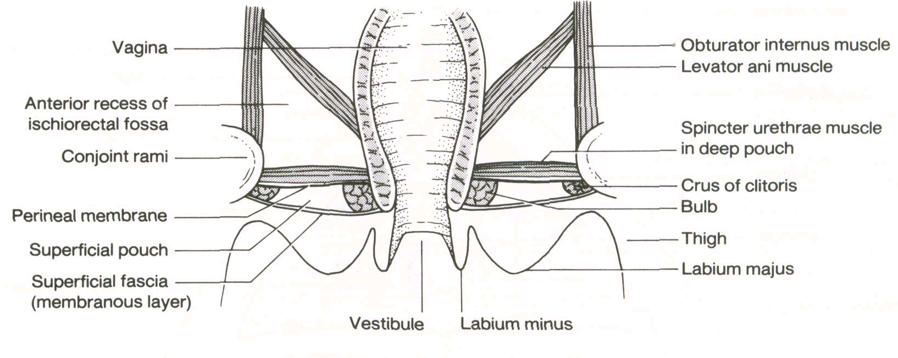
Coronal section of the vagina showing its relationship to the pelvic and urogenital organs.

Slide 16
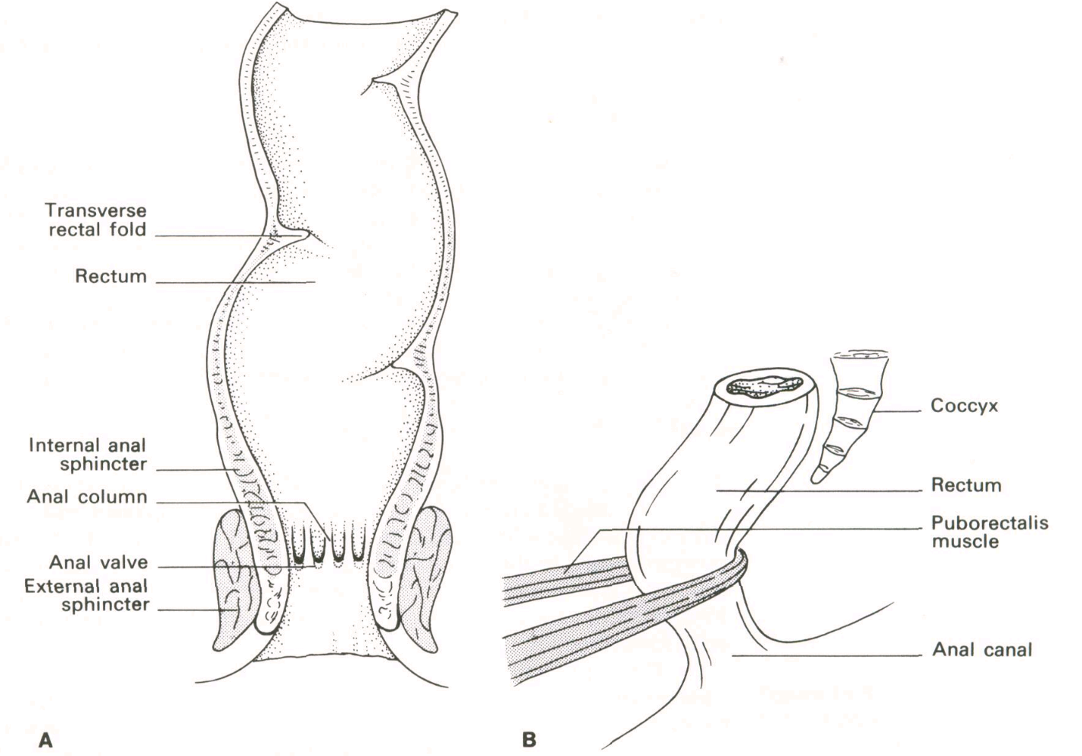
Rectum and anal canal. A. Coronal section. B. Lateral view showing puborectalis muscles.

Slide 17
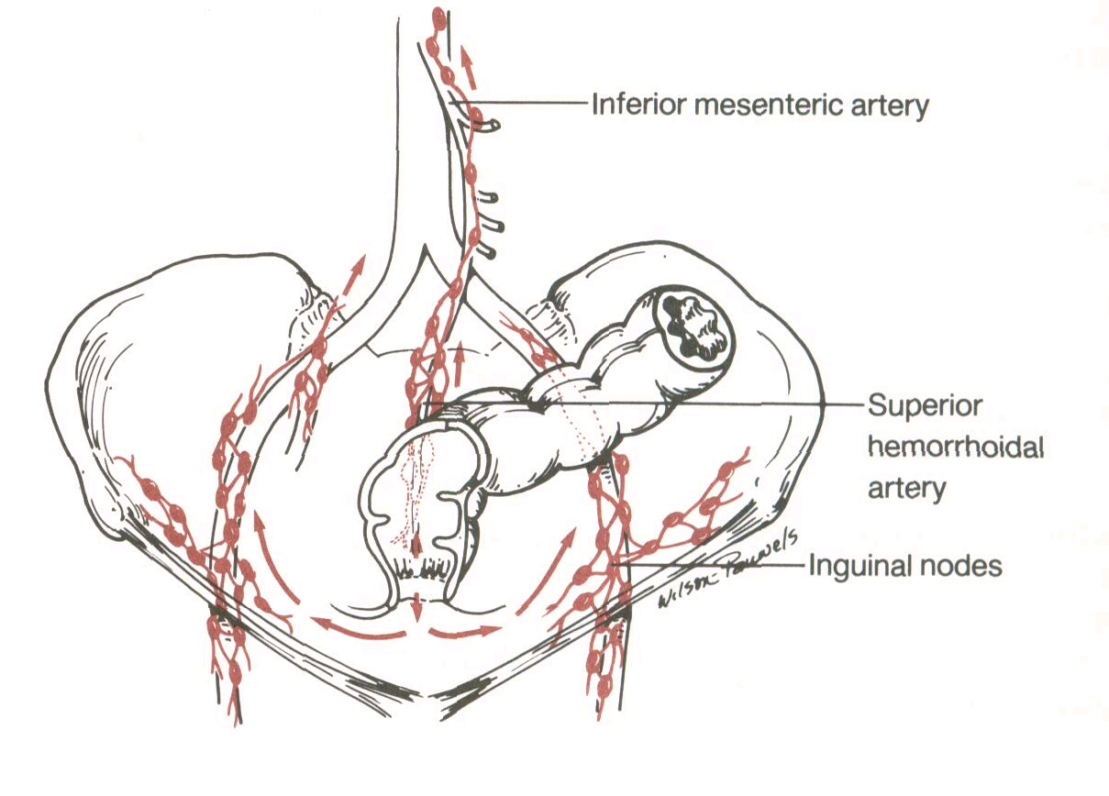
Lymphatic drainage of rectum, anal canal, and anus.

Slide 18
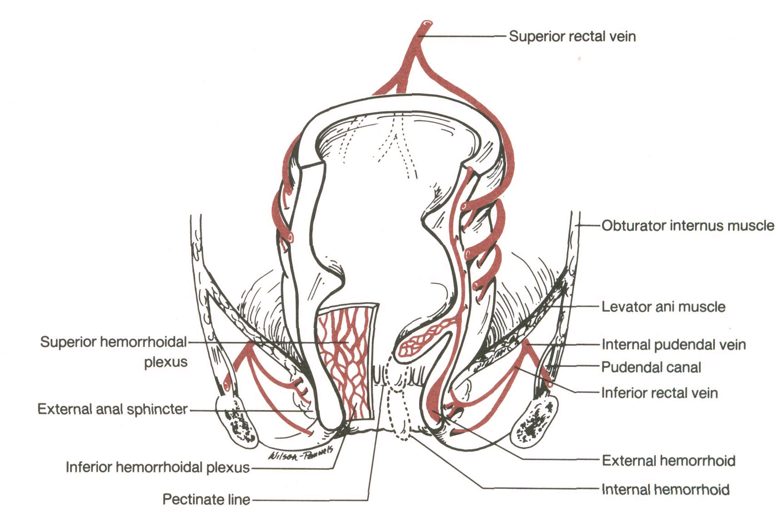
Venous drainage of the rectum and anus showing internal and external hemorroids.

Slide 19
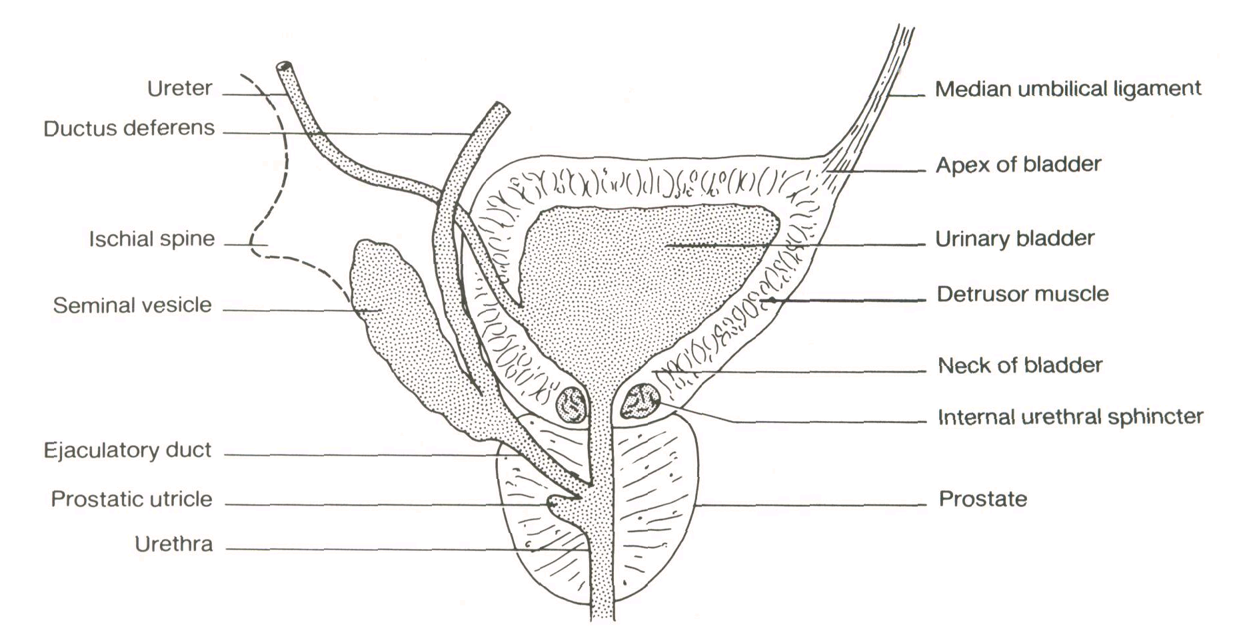
Schematic sagittal section of the urinary bladder and internal genitalia in males.

Slide 20
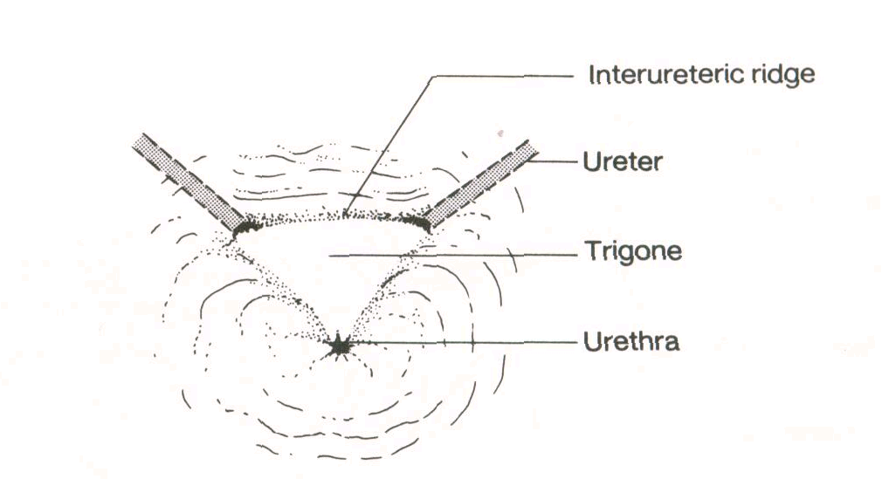
The trigone of the bladder.

Slide 21
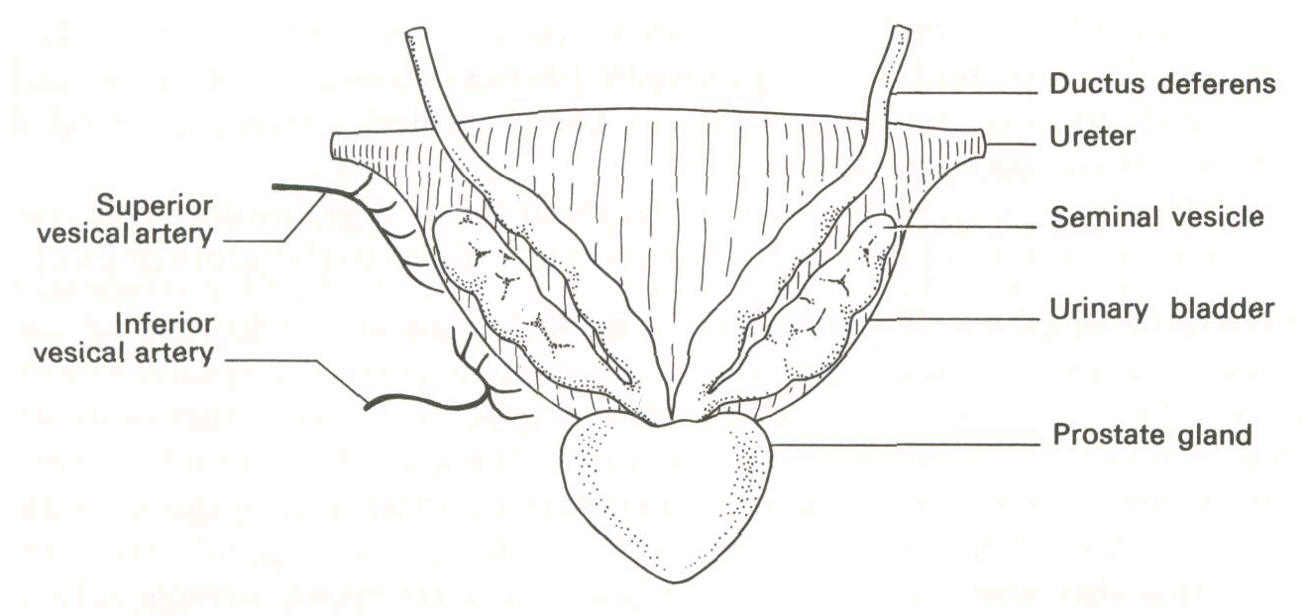
Posterior view of base of the bladder and adjacent organs.

Slide 22
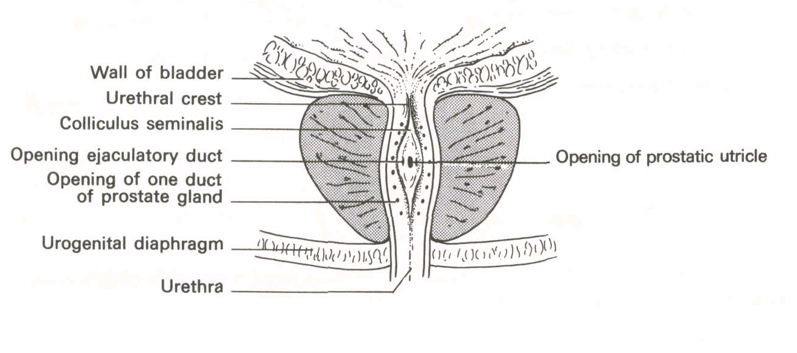
Coronal section of the prostatic urethra showing its posterior wall.

Slide 23
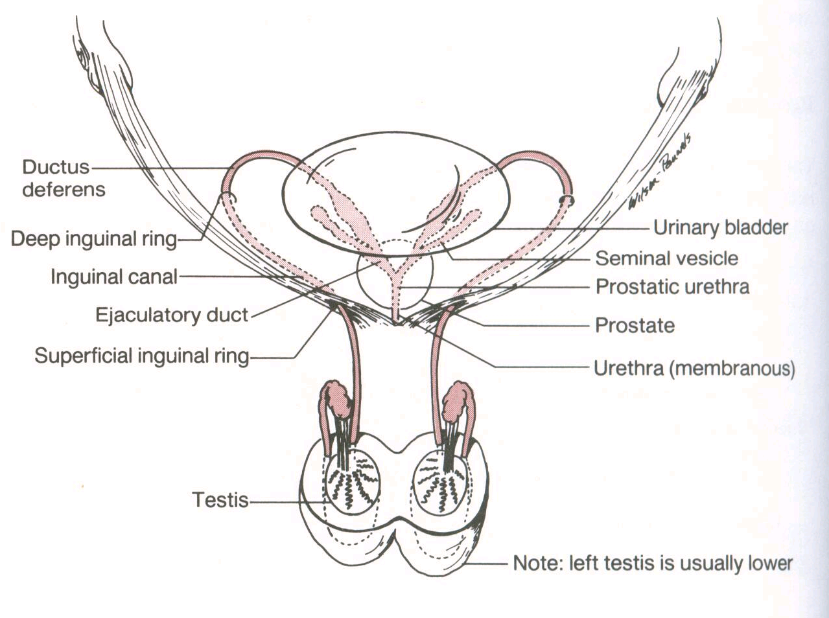
Course of the ductus deferens.

Slide 24
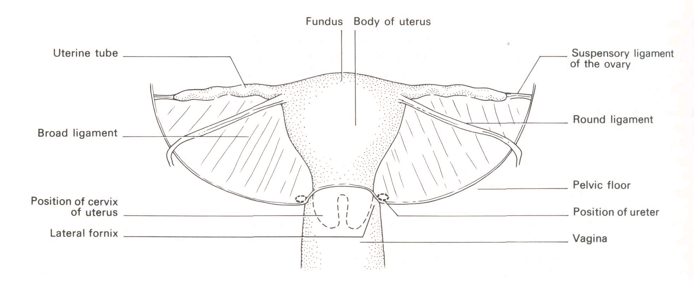
Anteroinferior view of the uterus and broad ligament.

Slide 25
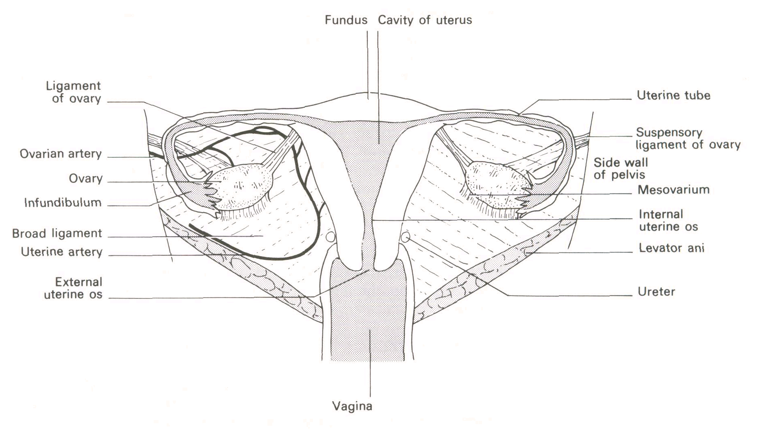
Ovary and uterus (posterior view).

Slide 26
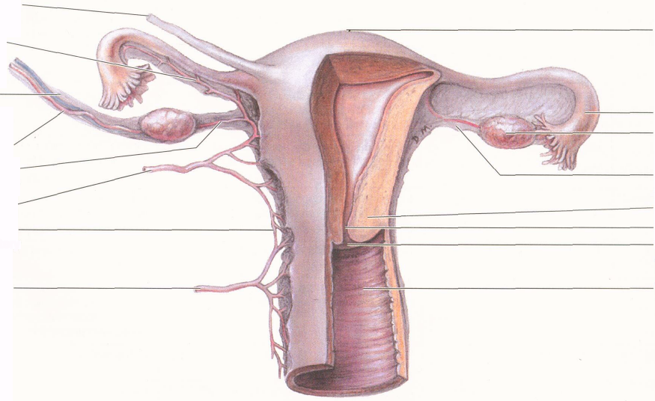

Slide 27
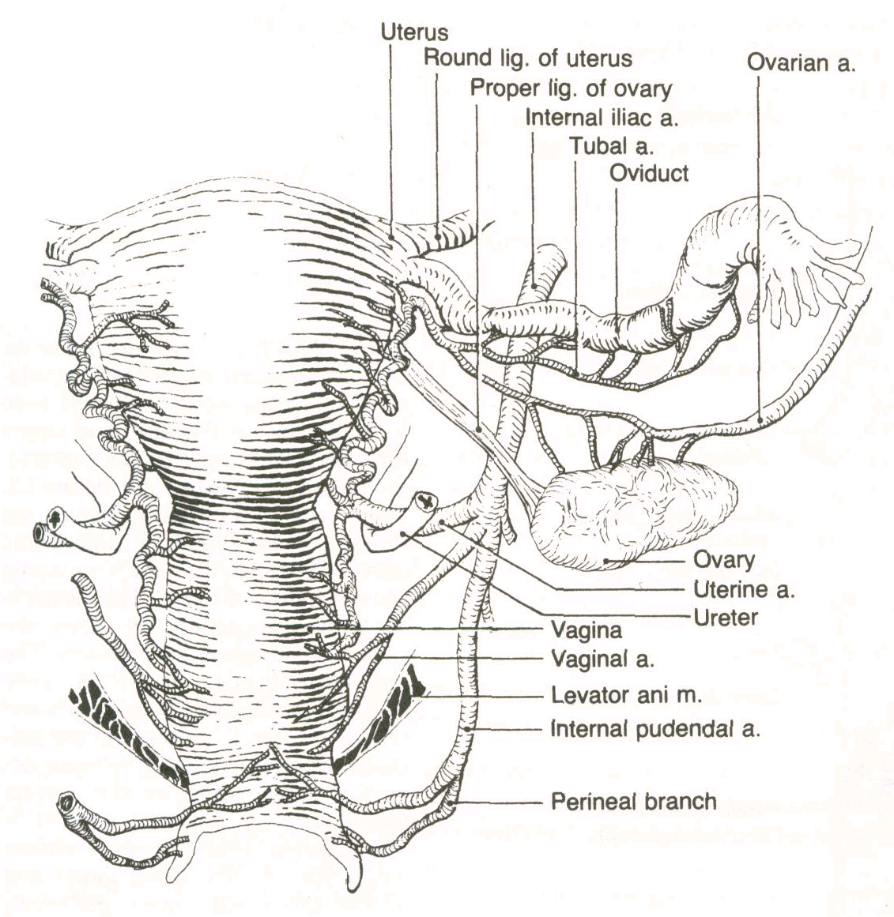
Vasculature of the female reproductive tract. The ovarian, uterine, and pudendal arteries supply the female tract and genitalia with anastomoses occurring between the ovarian and uterine arteries as well as between the uterine arteries and deep perineal branches of the pudendal arteries.

Slide 28
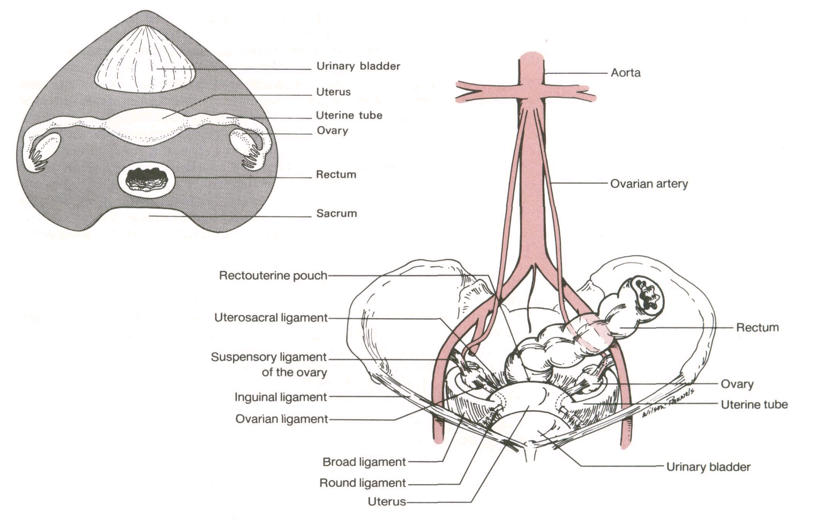
Anterior view of pelvic viscera (female). Inset shows a superior view of pelvic viscera.

Slide 29
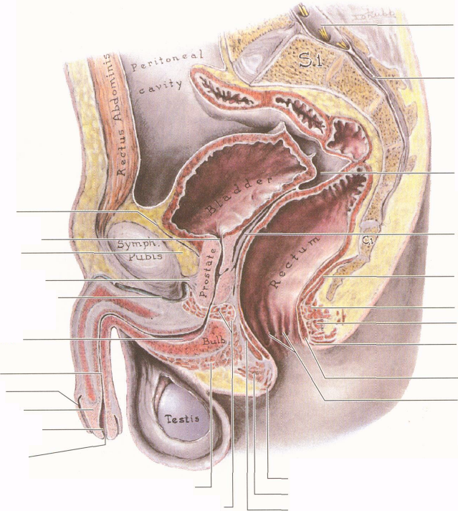

Slide 30
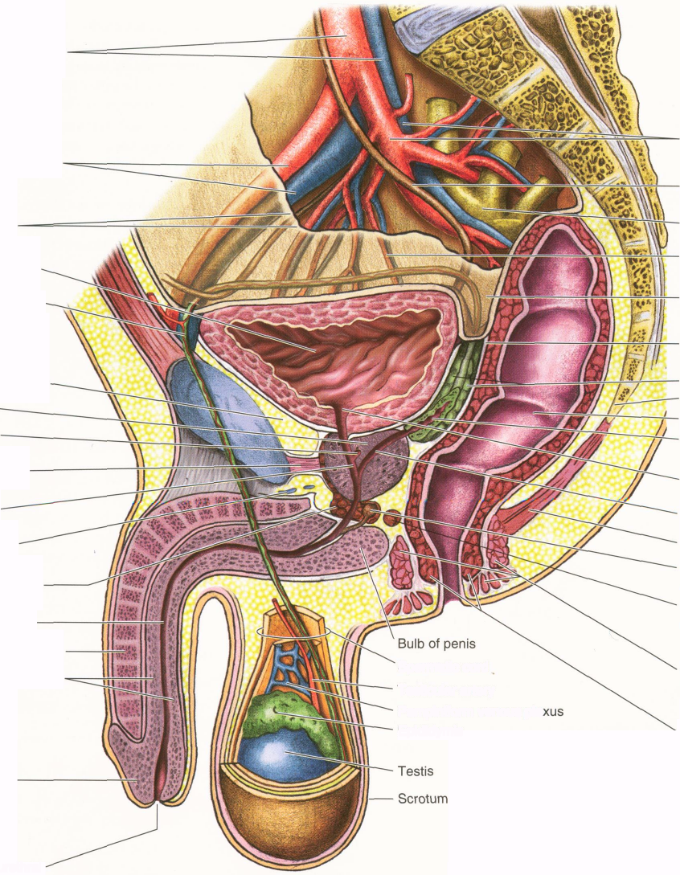

Slide 31
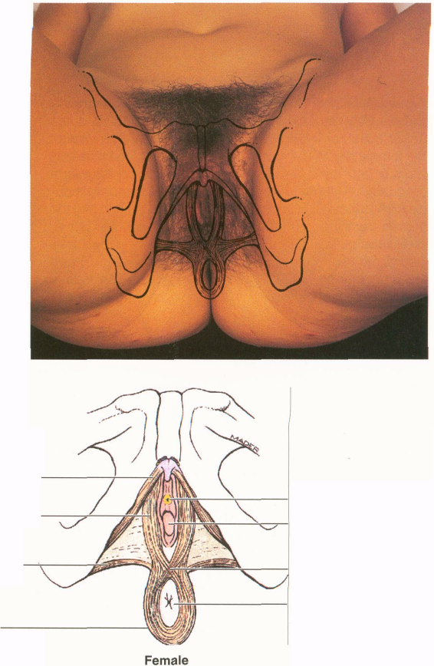

Slide 32
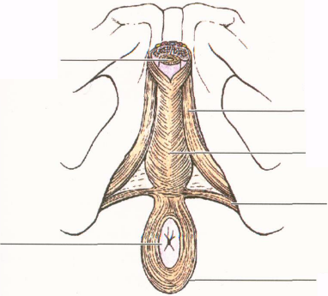

Slide 33
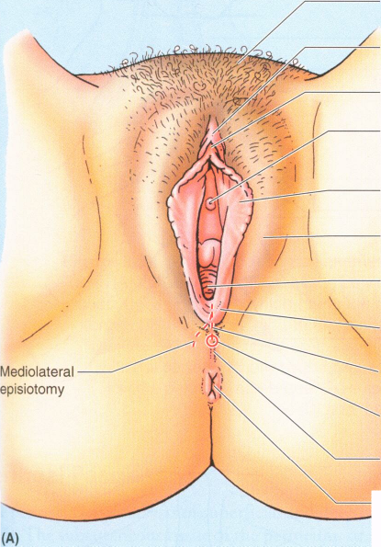

Slide 34
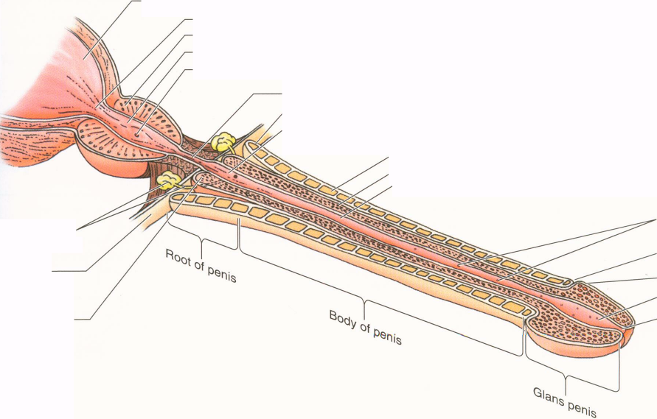

Slide 35
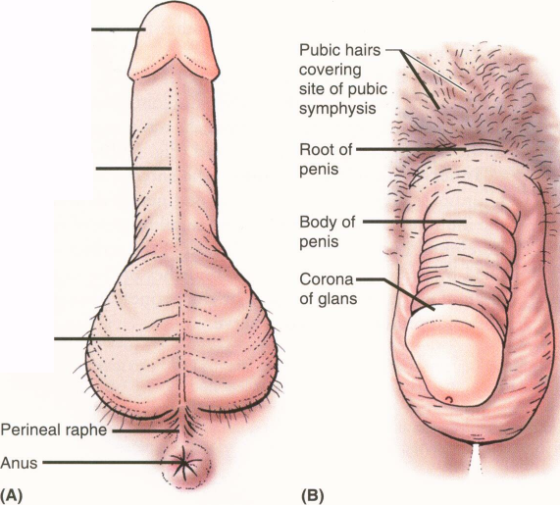

Slide 36
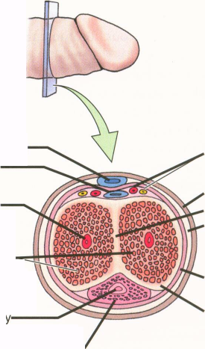

Slide 37
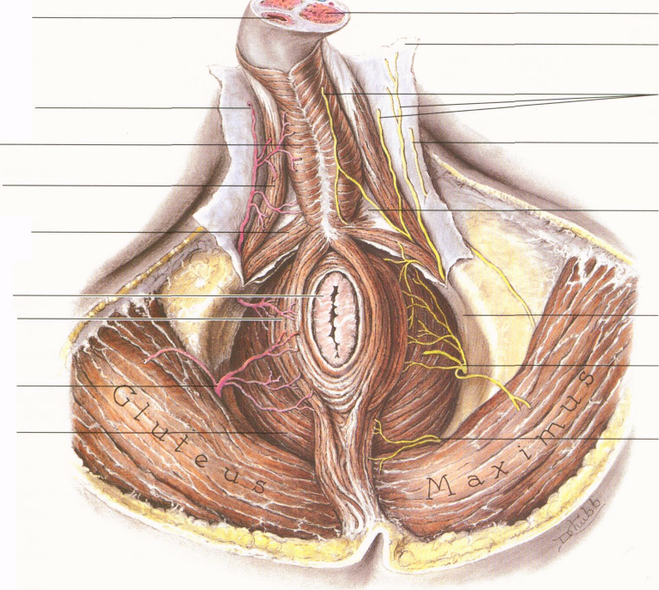

Slide 38
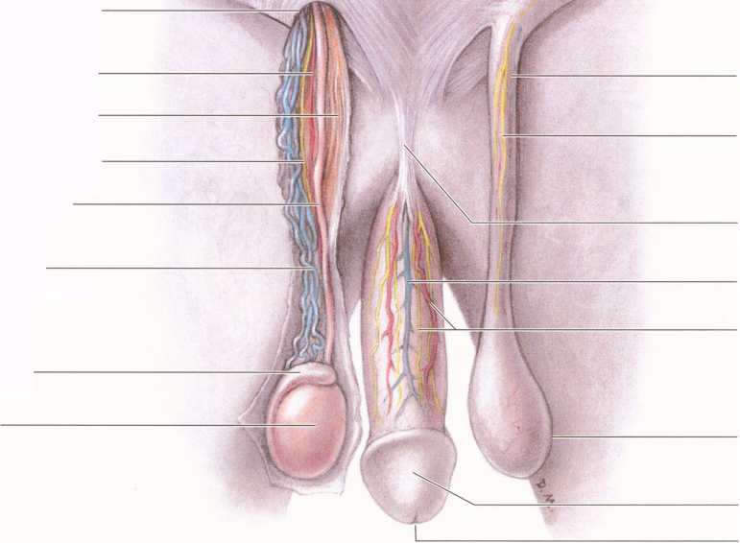

Slide 39
